Slide 1
Transfer data from FF to HANA through BODS
Milind Parab

Slide 2
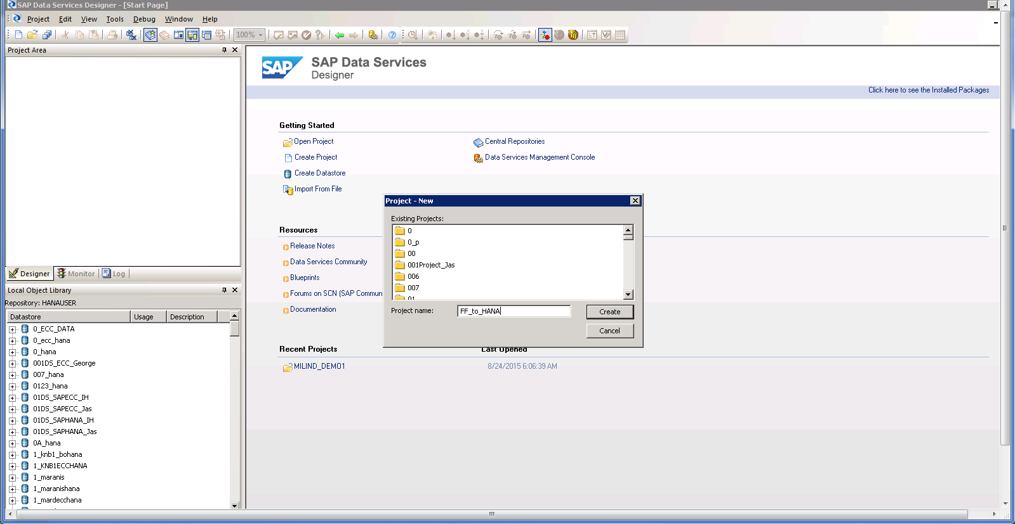
Create a Project.

Slide 3
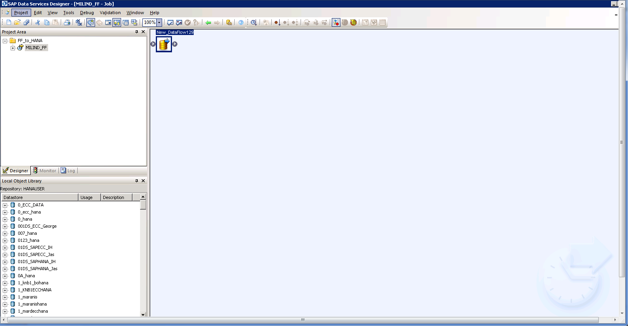
Create a new Job and add Data Flow.

Slide 4
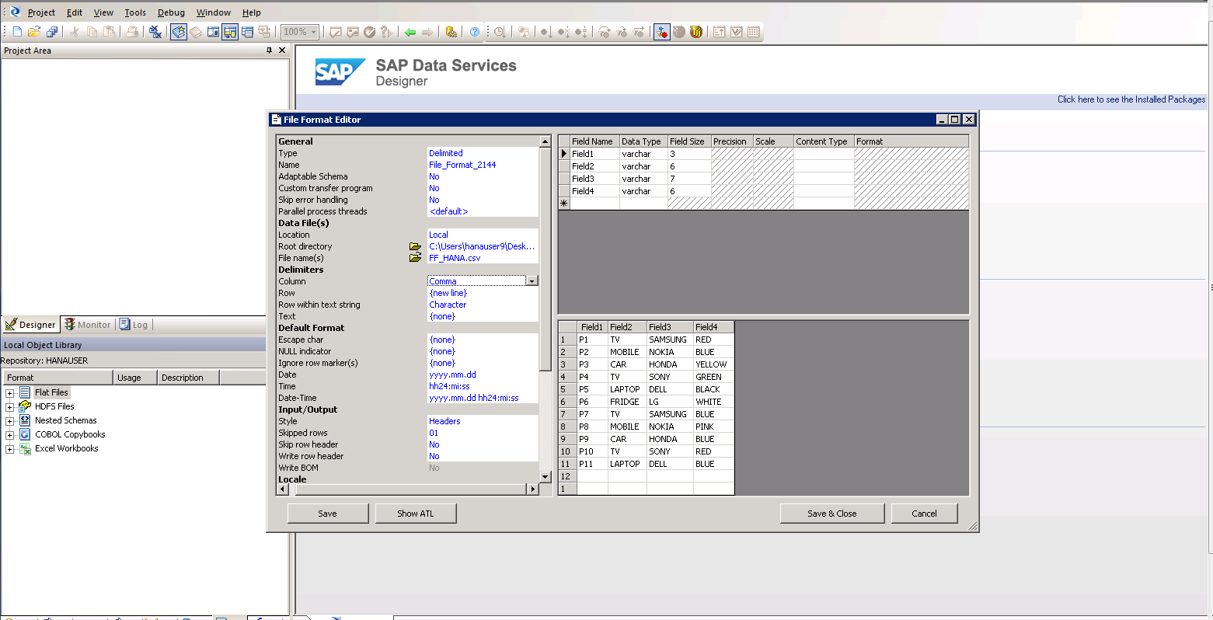
Select path for FF in SAP data services.

Slide 5
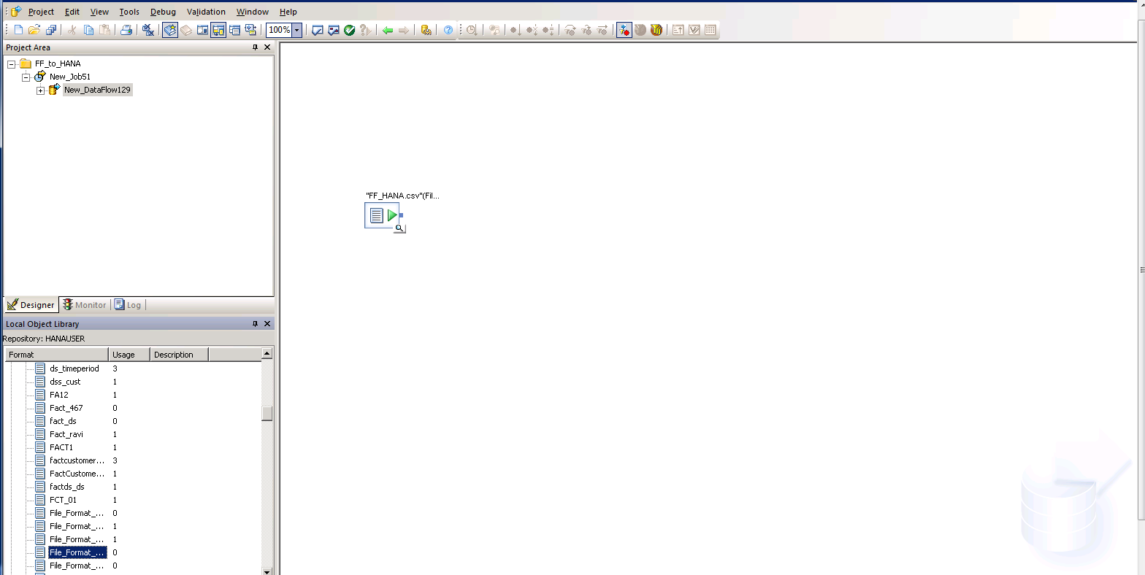
Add FF as a source.

Slide 6
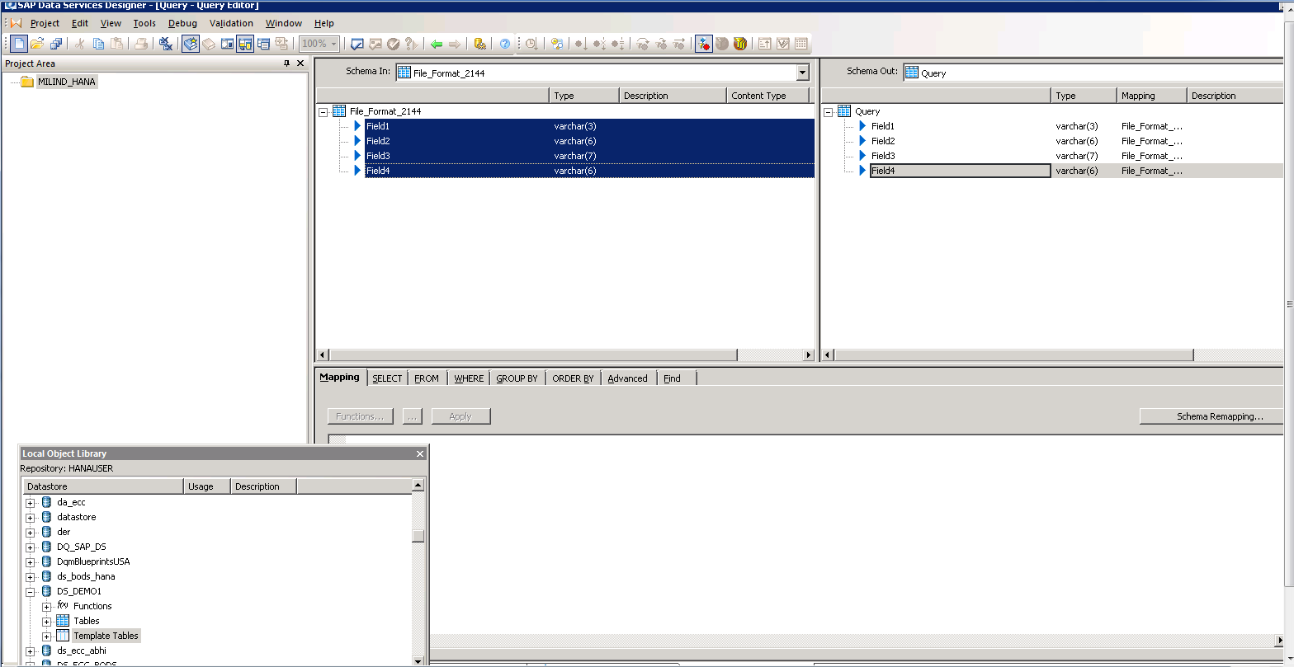
Add Source and Destination.

Slide 7
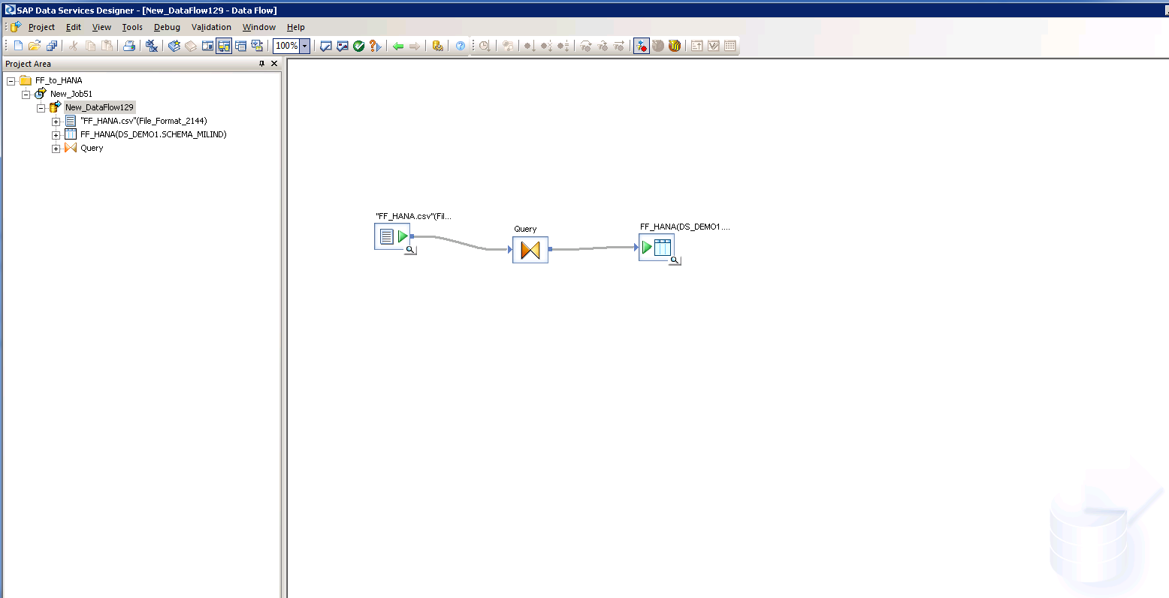
Now, execute.

Slide 8
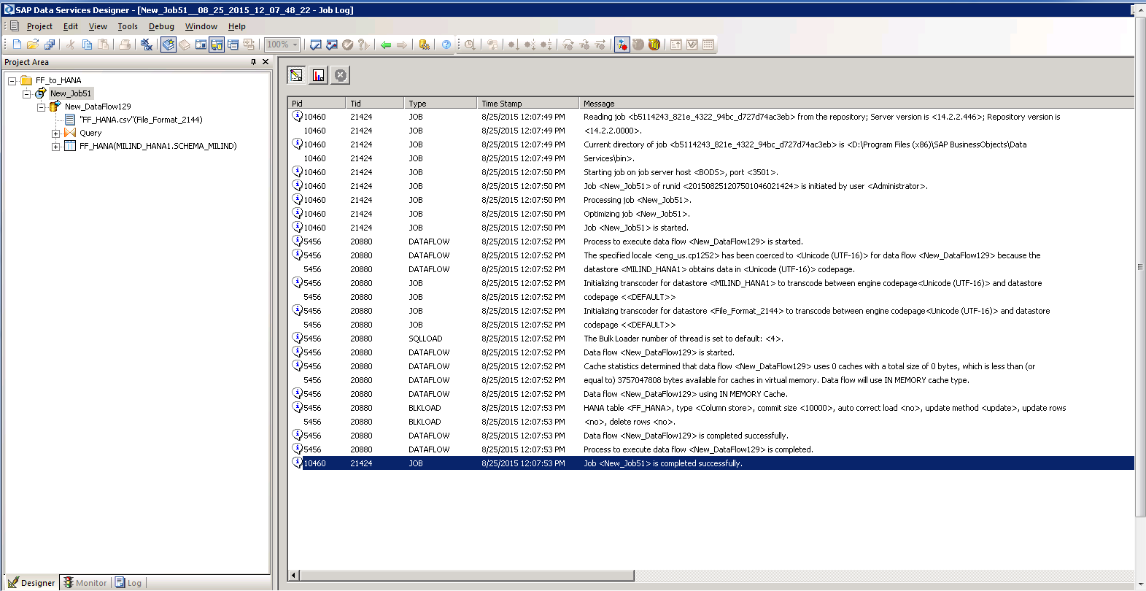
Job completed successfully.

Slide 9
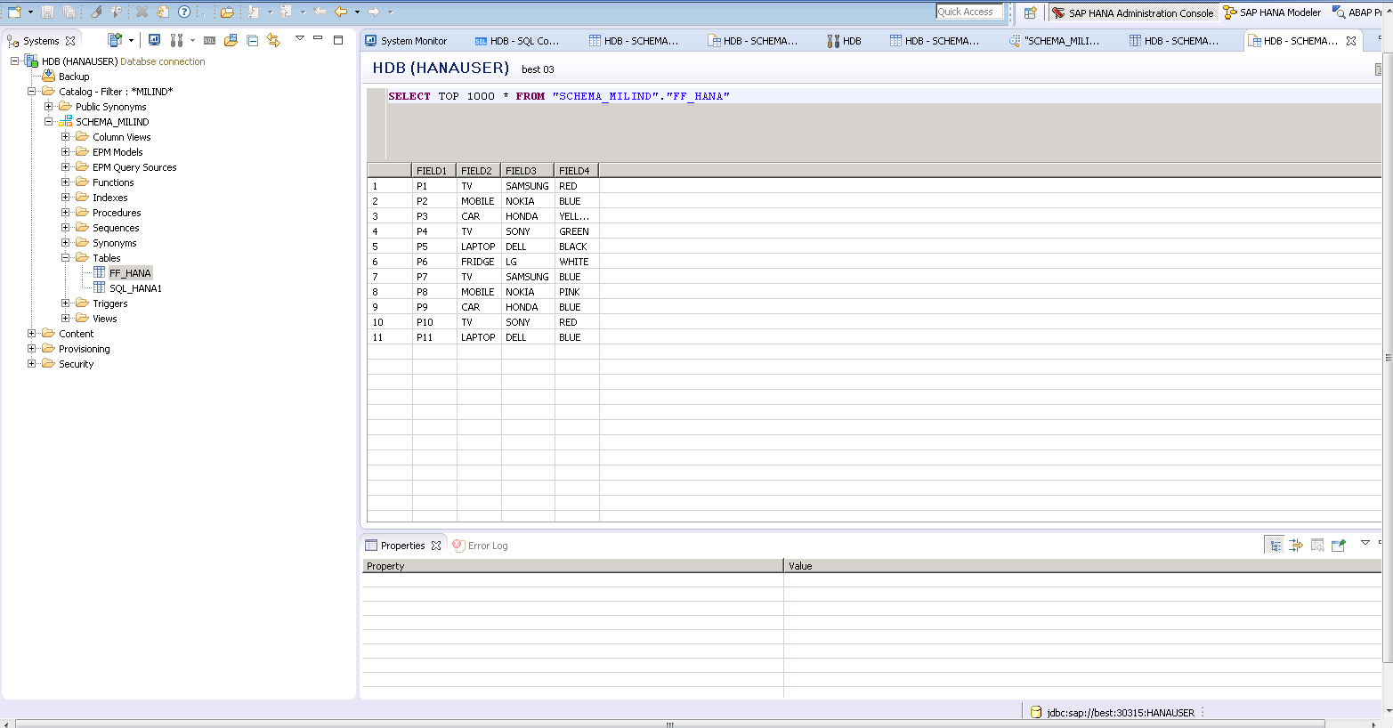
You can log on to HANA studio to check the table content.

